Slide 1
LINEAR REGRESSION
Jasmine Wilkerson
jasmine@datasciencedojo.com

Slide 2
Linear Regression-Overview
Difference between Regression and Classification
Linear Regression
Motivating Example: Predicting Housing Prices
Hypothesis function
Cost Function
Gradient Descent
Probabilistic Interpretation
Applying linear regression for hand digit recognition

Slide 3
Supervised Learning
Data: D = { d₁, d₂, d₃,……….,d_{n}} a set of n examples
d_{i}= < x_{i}, y_{i}>
x_{i}
Input vector
Independent variables
Explanatory variables
Features
Predictors
y_{i}
Output scalar
Dependent variables
Response
Outcome
Notes:
Teacher could be the human judges for query results for instance.

Slide 4
Supervised Learning
Regression: X discrete or continuous Y is continuous
Eg. Prices, Weight, Height, signal measurement, temperature etc.
Classification : X discrete or continuous Y is discrete
Objective: learn the mapping of f : X_{i} Y_{i}

Slide 5
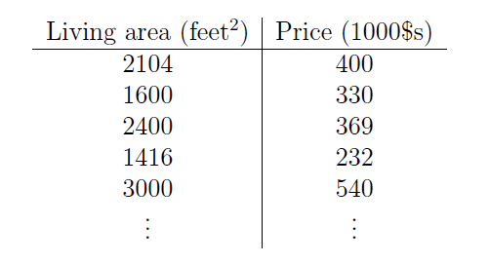
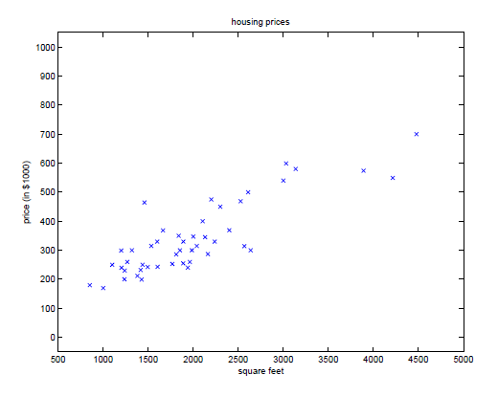
Predict Housing Prices
Can we learn to predict the price when the price of the house is not in the dataset? Living Area = 3500 sq. ft. Price = ?

Slide 6
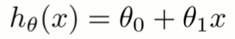
Predict Housing Prices
Can we learn to predict the price when the price of the house is not in the dataset?
Living Area = 3500 sq. ft. Price = ?
Use the line that is somewhere in the middle
How do we define somewhere in the middle?
Notes:
Which line is the best fit?

Slide 7
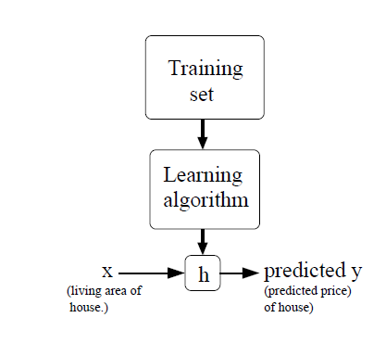
Training Process In Linear Regression
Objective: learn the mapping of f : X_{i} Y_{i}
Finding h is the goal here
h is known as the hypothesis
Notes:
H is used for hypothesis.
The goal of a supervised learning algorithm is to learn a hypothesis (or a function like this.

Slide 8
Predict Housing Prices
x⁽¹⁾
x⁽²⁾
x⁽³⁾
x⁽⁴⁾
x⁽⁵⁾
.
.
.
x^{(m)}
y⁽¹⁾
y⁽²⁾
y⁽³⁾
y⁽⁴⁾
y⁽⁵⁾
.
.
.
y^{(m)}
m = Total number of training set
θ _{j} = Parameters
Notes:
Which line is the best fit?

Slide 9
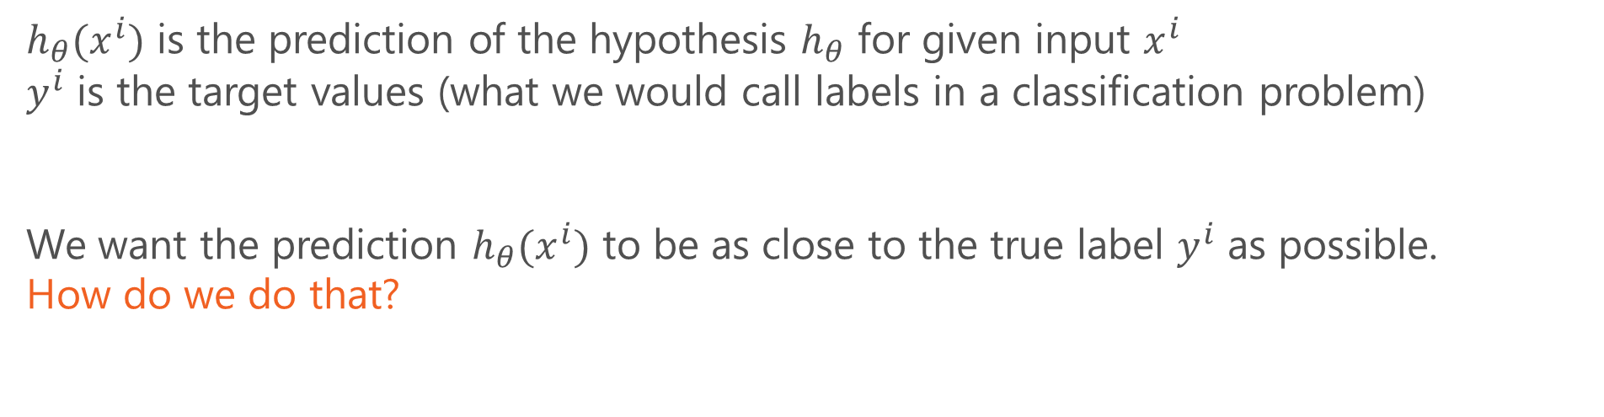
Hypothesis Function-Linear regression
$h_{θ}(x^{i})$ is the prediction of the hypothesis $h_{θ}$ for given input $x^{i}$
$y^{i}$ is the target values (what we would call labels in a classification problem)
We want the prediction $h_{θ}(x^{i})$ to be as close to the true label $y^{i}$ as possible.
How do we do that?
Notes:
Should be 1/2m

Slide 10
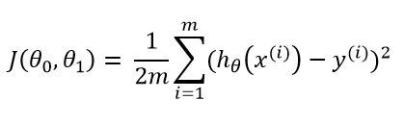
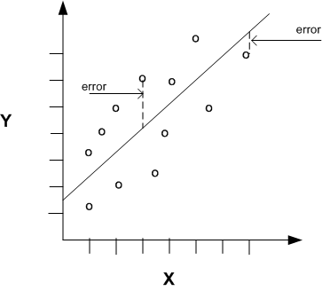
Cost Function
In Plain English
find a linear line that is as close to the actual outputs as possible.
Mathematically
Find linear function of X that minimizes the sum of squared residuals from Y.
a.k.a loss function
Notes:
Now use white board to break down cost function

Slide 11
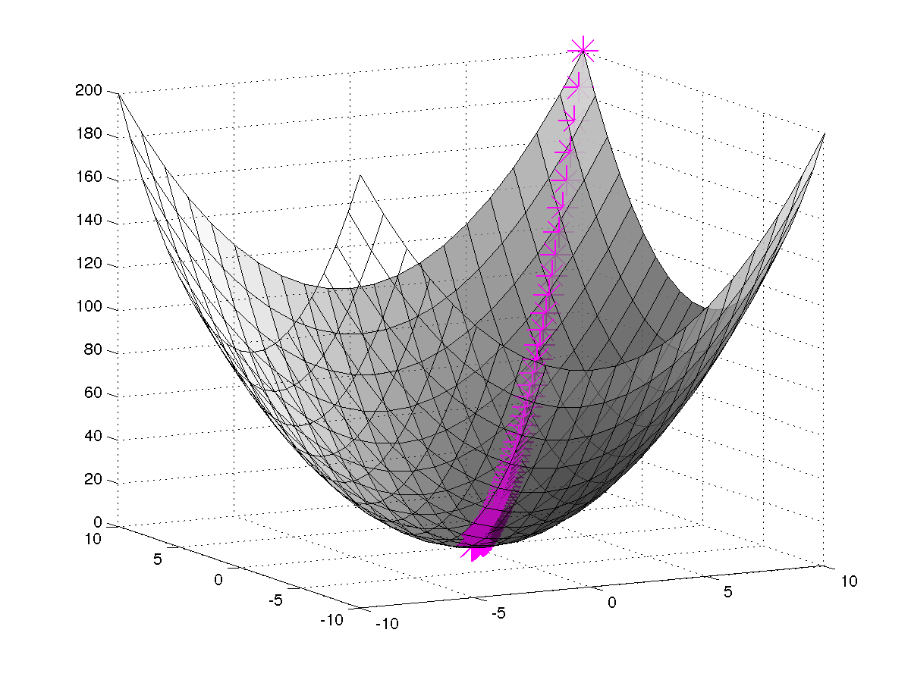
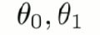
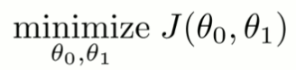
The Cost Function
Hypothesis:
Cost Function:
Parameters:
Goal:
Notes:
When there are two parameters, it will look like this, 3 dimensions. How do you minimize? Use algorithm

Slide 12
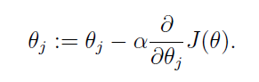
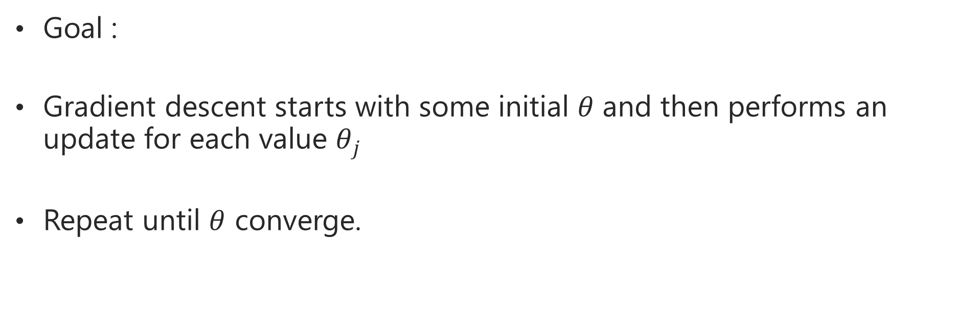
Gradient Descent Algorithm
Goal :
Gradient descent starts with some initial $θ$ and then performs an update for each value $θ_{j}$
Repeat until $θ$ converge.
Notes:
Break down the equation.

Slide 13
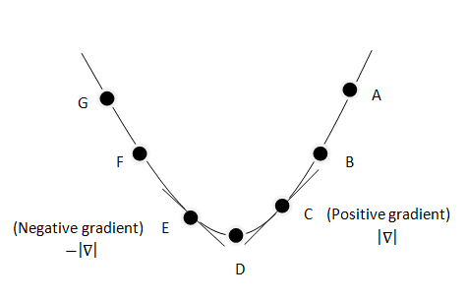
Gradient Descent Algorithm
Notes:
Show the derivatives

Slide 14
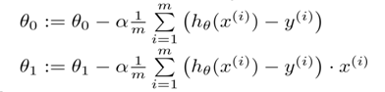
Gradient Descent Algorithm
Repeat until converge {
}
For j=0 and j= 1
Notes:
Show on white board what happen when the rate changes. Too slow vs too fast. Or, should I make slide for it?

Slide 15
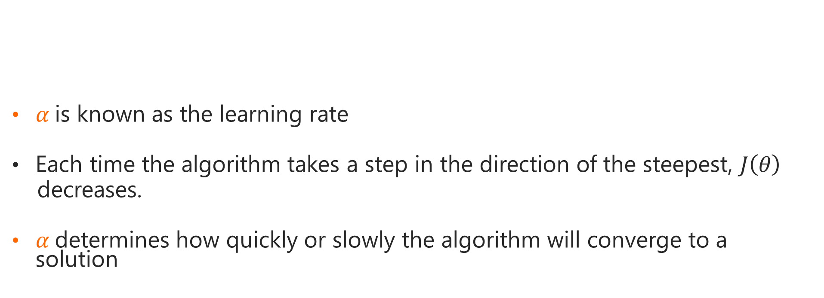
Gradient Descent Algorithm
$α$is known as the learning rate
Each time the algorithm takes a step in the direction of the steepest, $J\left(θ\right)$
decreases.
$α$determines how quickly or slowly the algorithm will converge to a solution
Notes:
Show on white board what happen when the rate changes. Too slow vs too fast. Or, should I make slide for it?

Slide 16
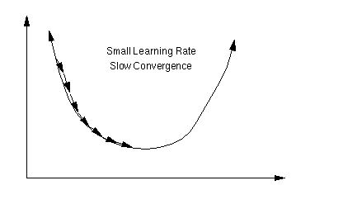
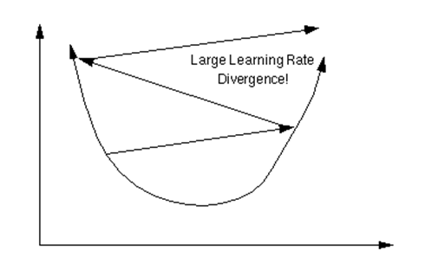
Gradient Descent Algorithm
Notes:
Show on white board what happen when the rate changes. Too slow vs too fast. Or, should I make slide for it?

Slide 17
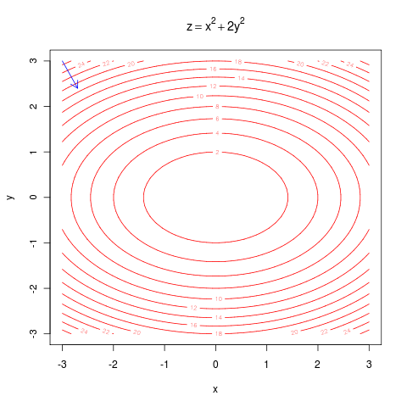
Digression - Gradient Descent Intuition

Slide 18
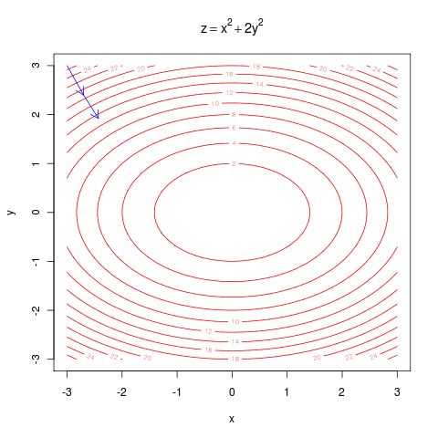
Digression - Gradient Descent Intuition

Slide 19
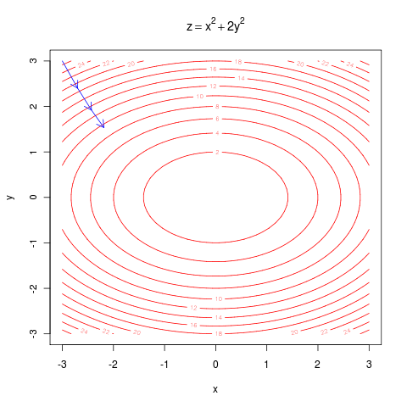
Digression - Gradient Descent Intuition

Slide 20
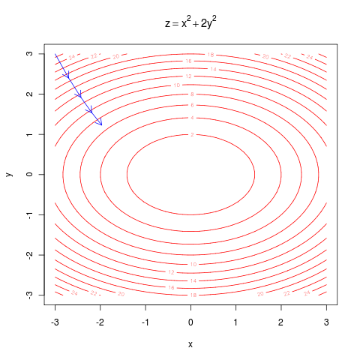
Digression - Gradient Descent Intuition

Slide 21
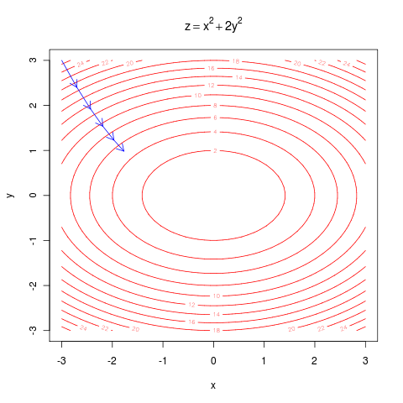
Digression - Gradient Descent Intuition

Slide 22
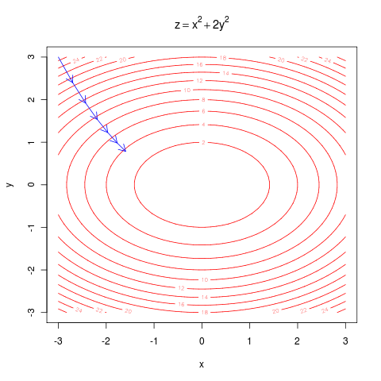
Digression - Gradient Descent Intuition

Slide 23
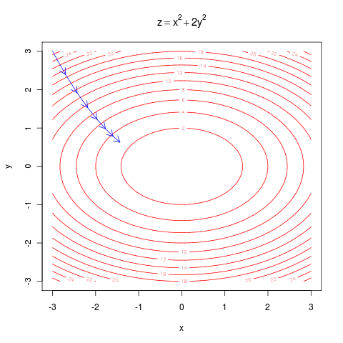
Digression - Gradient Descent Intuition

Slide 24
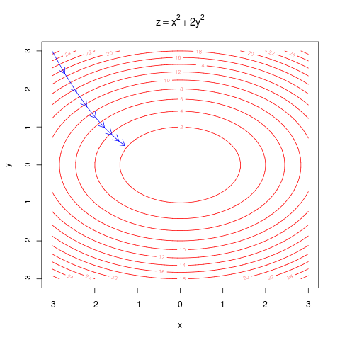
Digression - Gradient Descent Intuition

Slide 25
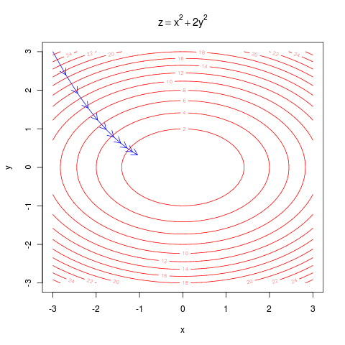
Digression - Gradient Descent Intuition

Slide 26

Digression - Gradient Descent Intuition

Slide 27
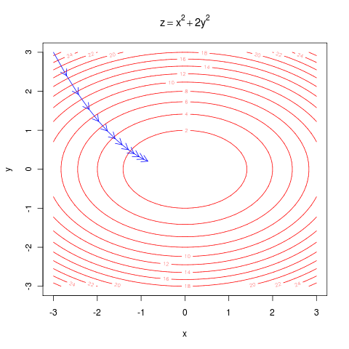
Digression - Gradient Descent Intuition

Slide 28

Digression - Gradient Descent Intuition

Slide 29

Digression - Gradient Descent Intuition

Slide 30
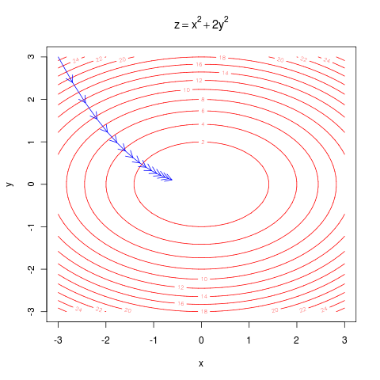
Digression - Gradient Descent Intuition

Slide 31

Digression - Gradient Descent Intuition

Slide 32

Digression - Gradient Descent Intuition

Slide 33

Digression - Gradient Descent Intuition

Slide 34

Digression - Gradient Descent Intuition

Slide 35
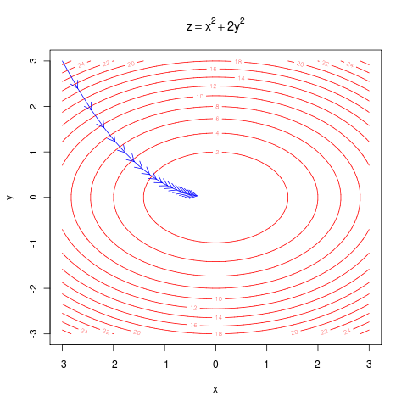
Digression - Gradient Descent Intuition

Slide 36
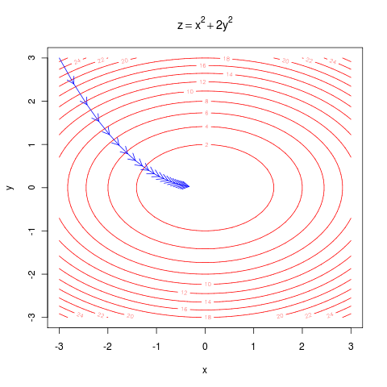
Digression - Gradient Descent Intuition

Slide 37
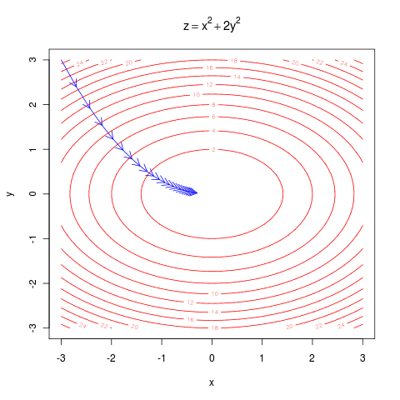
Digression - Gradient Descent Intuition

Slide 38
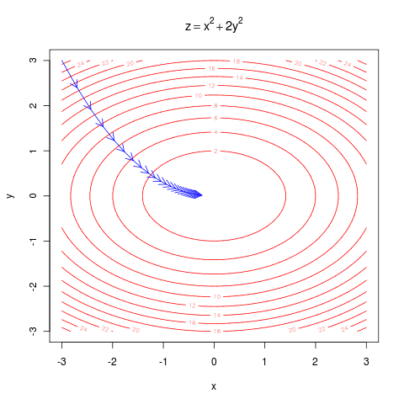
Digression - Gradient Descent Intuition

Slide 39

Digression - Gradient Descent Intuition

Slide 40
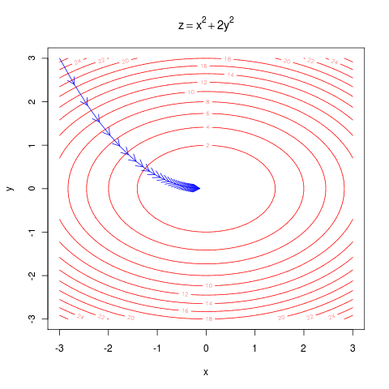
Digression - Gradient Descent Intuition

Slide 41

Digression - Gradient Descent Intuition

Slide 42
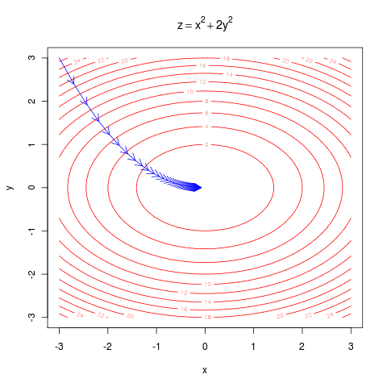
Digression - Gradient Descent Intuition

Slide 43

Digression - Gradient Descent Intuition

Slide 44
Multivariate Linear Regression

Slide 45
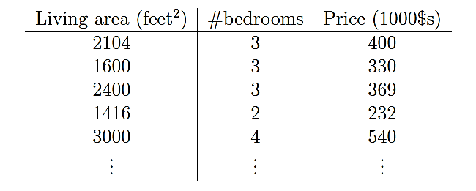
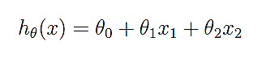
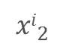
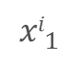
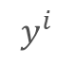
Predict Housing Prices – With Two Features
$${xi}_{1}$$
$${xi}_{2}$$
$$y^{i}$$
A linear function is just one of the choices to approximate the target variable.
$θ$ is the space of linear functions mapping the space of input variables to the output/target variables
Notes:
Move to multivariates

Slide 46
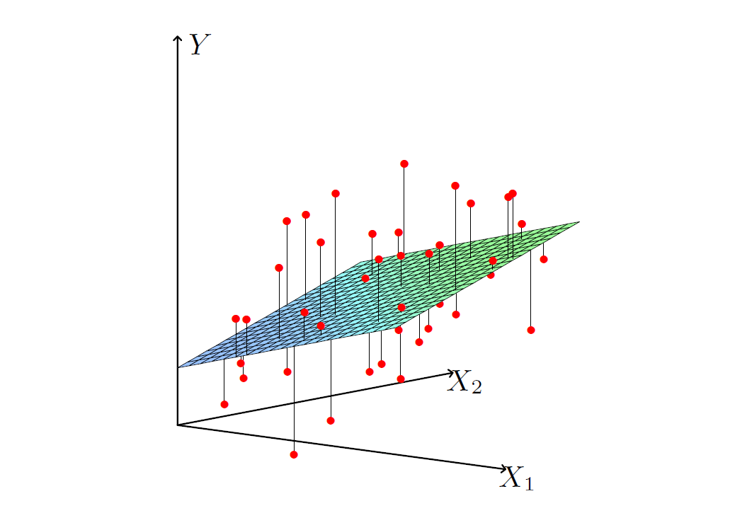
Predict Housing Prices – With Two Features
When we have two features, the linearity is in plane instead of line.
Notes:
Move to multivariates

Slide 47
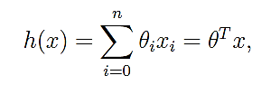
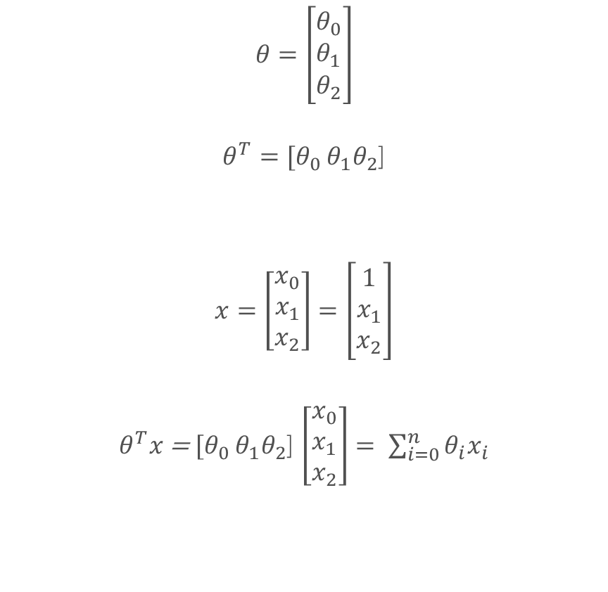
Algebraic Notation
$$θ=\left[\begin{matrix}θ_{0} \\ θ_{1} \\ θ_{2}\end{matrix}\right]$$
$θ^{T}=[θ_{0 }θ_{1}θ_{2}$]
$x=\left[\begin{matrix}x_{0} \\ x_{1} \\ x_{2}\end{matrix}\right]$ $=\left[\begin{matrix}1 \\ x_{1} \\ x_{2}\end{matrix}\right]$
$θ^{T}x$ = $[θ_{0 }θ_{1}θ_{2}$] $\left[\begin{matrix}x_{0} \\ x_{1} \\ x_{2}\end{matrix}\right]= \sum_{i=0}^{n}{θ_{i}x_{i}}$
The function approximating the target variable y is given by:
as
Notes:
Show on white board to visualize matrix, transpose, elaborate more matrices

Slide 48

Gradient Descent Intuition
Notes:
Remind the audience that theta is a vector. Local minimun vs global minimun

Slide 49
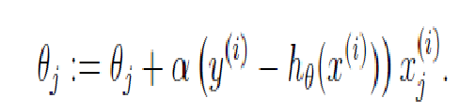
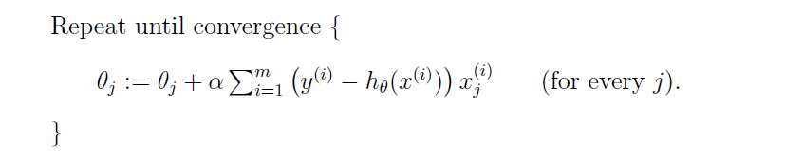
Batch Gradient Descent
For ONE training examples, we get the following update rule:
What do we observe here about the magnitude of the update?
For ALL training examples, we get the following update rule:
Notes:
Spend some time here talking about how the update is taking place here.

Slide 50
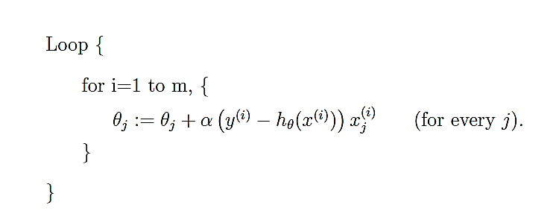
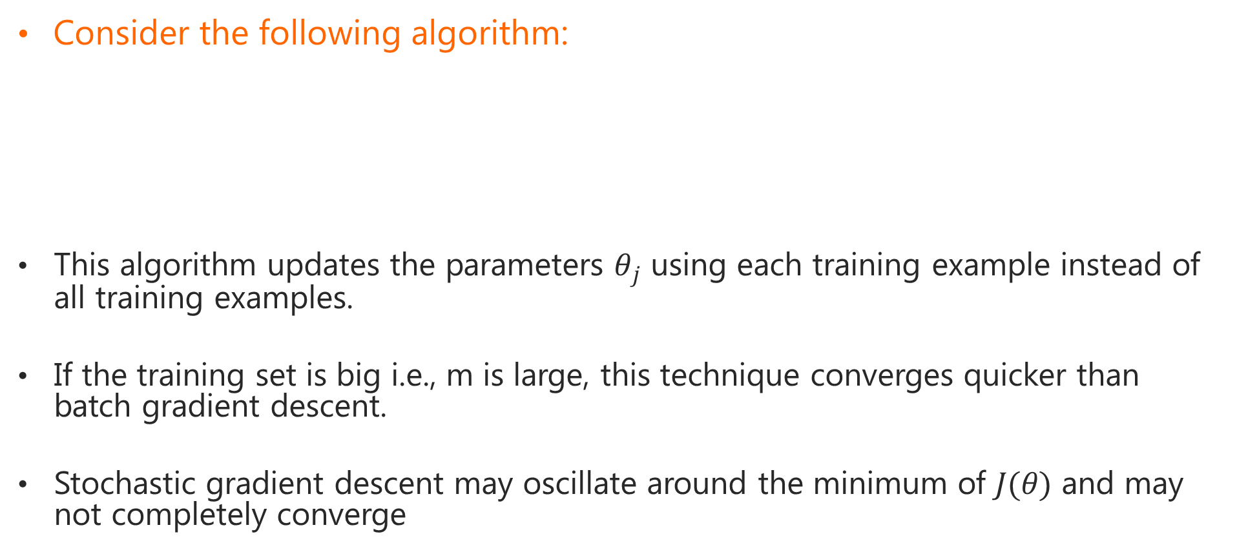
Stochastic Gradient Descent
Consider the following algorithm:
This algorithm updates the parameters $θ_{j}$ using each training example instead of all training examples.
If the training set is big i.e., m is large, this technique converges quicker than batch gradient descent.
Stochastic gradient descent may oscillate around the minimum of $J(θ)$ and may not completely converge

Slide 51
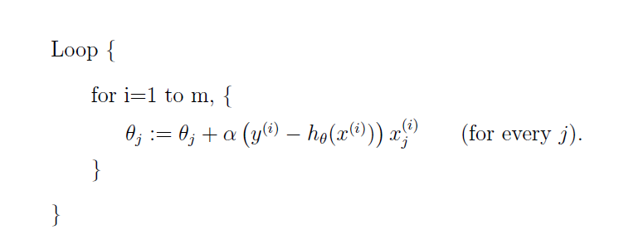
Batch vs. Stochastic Gradient Descent
Batch Gradient Descent
To update each parameter value, scan through the whole training data
Converges to the minimum value slowly
Preferred for small datasets
Stochastic Gradient Descent
Update the parameter values with one training example at a time
Converges to the ‘proximity’ of minimum value fast but may keep oscillating near the minimum
Preferred for large datasets
Notes:
Gradient descent technique does not take into account explicit derivatives.
Normal equation is obtained when we take derivative explicitly.
Talk about this approach before talking about Normal equations.

Slide 52
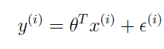
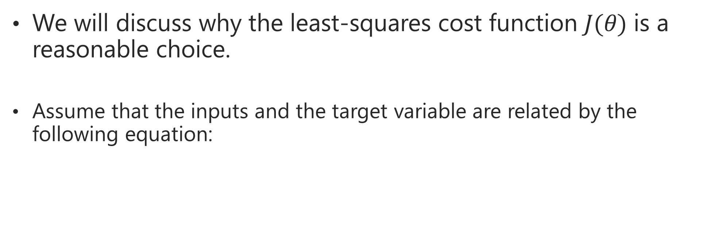
Probabilistic Interpretation of Linear Regression
We will discuss why the least-squares cost function $J(θ)$ is a reasonable choice.
Assume that the inputs and the target variable are related by the following equation:
Notes:
Describe here what is input, what is a target variable

Slide 53
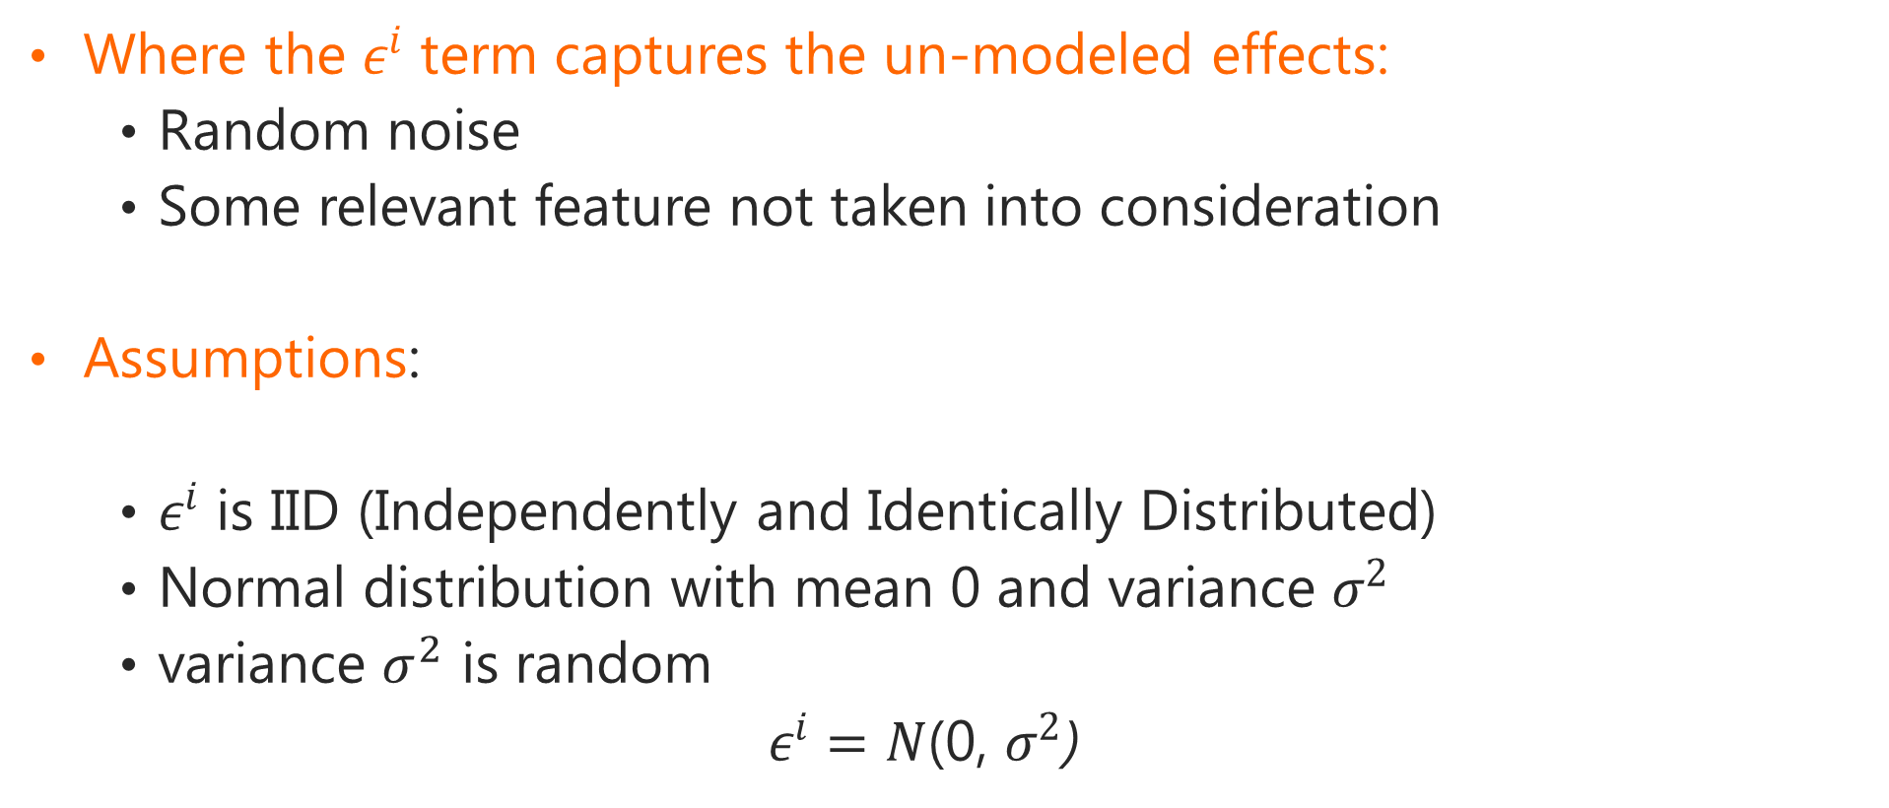
Probabilistic Interpretation of Linear Regression
Where the $ε^{i}$ term captures the un-modeled effects:
Random noise
Some relevant feature not taken into consideration
Assumptions:
$ε^{i}$ is IID (Independently and Identically Distributed)
Normal distribution with mean 0 and variance $σ^{2}$
variance $σ^{2}$ is random
$ε^{i}=N$(0, $σ^{2}$)

Slide 54




Probabilistic Interpretation of Linear Regression
The density of $ε^{i}$ is given by
We can rewrite:
This is the distribution of $y^{i}$given $x^{i}$and parameterized by $θ$

Slide 55



Probabilistic Interpretation of Linear Regression
Probability of observing the data as a function of $θ$ is given by:
This is known as the likelihood function
Due to the independence assumption, we can rewrite:

Slide 56

Maximizing The Likelihood Function
Principle of maximum likelihood: Choose $θ$ that makes the observed data as high probability as possible. In other words, choose $θ$ that maximizes $L(θ)$.
For mathematical ease, we can maximize the log of the likelihood function $L(θ)$ instead.

Slide 57


Maximizing The Log Likelihood Function
Maximizing $L(θ)$ is equivalent to minimizing J$(θ)$
Notes:
Explain why maximizing the log likelihood would not make any difference for a monotonically increasing function.

Slide 58
Linear Regression Using R
We will learn how to use linear regression for handwritten digit recognition now
Distinguishing between 2s and 3s
We will see some R code
For processing the inputs
Applying linear regression to learn a hypothesis
You can download R by searching ‘R download’

Slide 59

Example: Handwritten Digit Recognition

Slide 60

Extracting Features For Learning
{x₁, x₂, x₃ ………. X₂₅₆, y = ‘three’}
Each x_{i} corresponds to a feature value in the image
y is a label of the training data; can be numeric or categorical, ‘3’ or ‘three’
Each image is converted to row vectors and the appropriate learning algorithm is used
Convention
$x_{i}$ represents the i^{th} feature in a training sample
y represents the label for the training sample
Notes:
Xs features, predictors
Ys target variables, labels

Slide 61
Questions?

